Slide 1

Website Designing On Crypto Currency Trading Platform (Crypto-X Pro ) Presented By Sambhav Patni (BCA/45010/22, SP25) Under Supervisor Dr. Swati Prasad(Assistant Professor, Department of CSE)

Slide 2
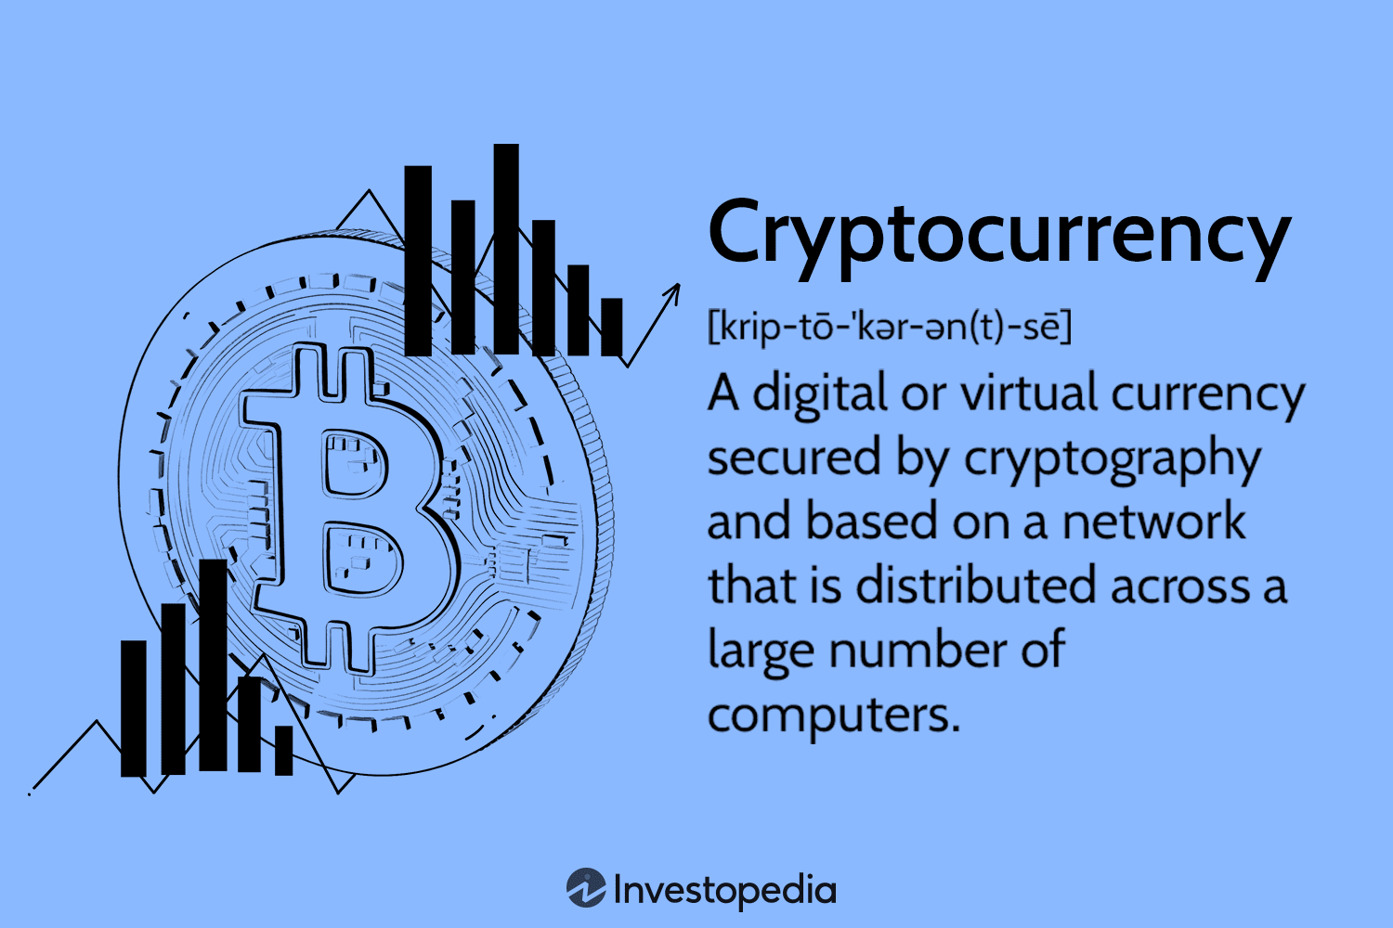

What is Crypto Currency Trading Platform?
Cryptocurrency is a digital or virtual currency secured by cryptography, meaning it exists only online.
It's a medium of exchange used to buy goods and services, with transactions recorded on a
public shared ledger called a blockchain. Unlike traditional currencies, cryptocurrencies are decentralized.
A cryptocurrency trading platform is an online marketplace for buying, selling,
and exchanging digital currencies like Bitcoin, Ethereum, and altcoins.
It operates like a stock exchange but focuses on digital assets instead of traditional stocks.
Some platforms support fiat-to-crypto transactions, while others allow only crypto-to-crypto trading.

Slide 3
Why Crypto Currency Platform?
Crypto makes it possible to transfer value online without the need for a middleman like a bank or payment processor, allowing value to transfer globally
1. Financial Inclusion – They provide access to global financial markets without requiring traditional banking services.
2. Decentralization – Some platforms are decentralized, reducing reliance on a single governing body and enhancing security.
3. Profit Opportunities – Traders can earn profits through various strategies like spot trading, futures trading, and staking.
4. Liquidity and Market Efficiency – These platforms facilitate high-volume trading, improving liquidity and fair price discovery.

Slide 4
Objectives
1. To develop a website which will help in facilitating crypto trading for the traders to get better user experience and facilities for trading with real time updates/news.
2. The following features will be added on the website:
Develop a scalable infrastructure that maintains performance under high load
Provide comprehensive educational resources for cryptocurrency trading
Build a platform that supports multiple cryptocurrencies and trading pairs
3. Support Portfolio Tracking and Performance Analysis - Allow users to monitor their holdings, track profit and loss, and analyze portfolio allocation (e.g., percentage in crypto vs. cash) to facilitate better investment decisions
4. Deliver a User-Friendly and Secure Experience - Design an intuitive interface suitable for both novice and experienced traders and ensuring ease of navigation and efficient execution of trades, Implement robust security measures such as encryption
5. Provide Advanced Trading Tools and Analytics - real-time price tracking, and comprehensive portfolio management features to help users analyze market trends and make informed trading decisions

Slide 5
Abstract
The cryptocurrency trading platform is a digital marketplace that operates on the principles of cryptocurrency, which is a digital or virtual currency secured by cryptography and relies on a decentralized system to record transactions and manage the creation of new units, typically using a public ledger called a blockchain. This project study focusses on developing website for trading cryptocurrency. It facilitates the buying, selling, and trading of various cryptocurrencies in a secure and user-friendly environment. Name the technology has been utilized for providing real-time market data analysis, enabling users to make informed trading decisions. Key features include user authentication and security, market analysis tools, various order types, wallet integration, liquidity and trading pairs, API access, and regulatory compliance. By focusing on robust security features and innovative functionalities, the platform aims to empower both novice and experienced traders, offering a comprehensive trading experience that combines security, functionality, and ease of use. Additionally, it sets itself apart from other cryptocurrency trading platforms through its user-centric design and educational resources.

Slide 6
Motivation and Challenges
Motivations:
Growing mainstream adoption of cryptocurrencies
Increasing demand for secure trading environments
Need for platforms that bridge the knowledge gap for new users
Opportunity to provide advanced tools for experienced traders
Potential to integrate DeFi (Decentralized Finance) functionalities
Challenges:
Regulatory compliance across multiple jurisdictions
Security threats and evolving attack vectors
Scalability during market volatility
User interface that balances simplicity with advanced functionality
Integrating multiple blockchain networks
Managing liquidity across trading pairs

Slide 7
Requirement gatherings And Analysis
Stakeholders:
Primary Stakeholders:
Retail traders (beginner to advanced)
Institutional investors
Platform operators and administrators
Secondary Stakeholders:
Regulatory bodies
Liquidity providers
Strategic partners (payment processors, custody solutions)
Marketing and customer support teams
Development and security teams

Slide 8
Functional Requirements
Functional Requirements - User Management
Secure registration and KYC processes
Authentication of User after Registering redirects to login
Account management and preferences
Wallet integration and management
User activity monitoring and reporting
Functional Requirements - Trading Features
Real-time order book and market data
Trading pair support across different cryptocurrencies
Portfolio management and performance tracking
Trading APIs for automated trading strategies
Functional Requirements - Platform Services
Fiat currency deposit/withdrawal methods
Cryptocurrency deposit/withdrawal across multiple networks
Educational resources and trading tutorials
Market analysis tools and indicators
News integration and market alerts

Slide 9
Non-Functional Requirements
Security
Cold storage for majority of assets
Regular security audits and penetration testing
Insurance coverage for digital assets
Real-time fraud detection systems
Compliance with industry security standards
Performance
Low-latency trade execution
Scalable infrastructure to handle market volatility
Efficient order matching engine
Usability:
Intuitive interface for various user skill levels
Mobile and desktop responsive design
Accessibility compliance
Compliance : Regulatory compliance in target jurisdictions , Data privacy and protection

Slide 10
Design
Technology Stack
Frontend: HTML, CSS, JavaScript, React - Web Sockets for real-time data
Backend: Node.js
Databases: SQL for user data
Blockchain integrations: Multiple network support
Security: Hardware security modules, encryption protocols

Slide 11
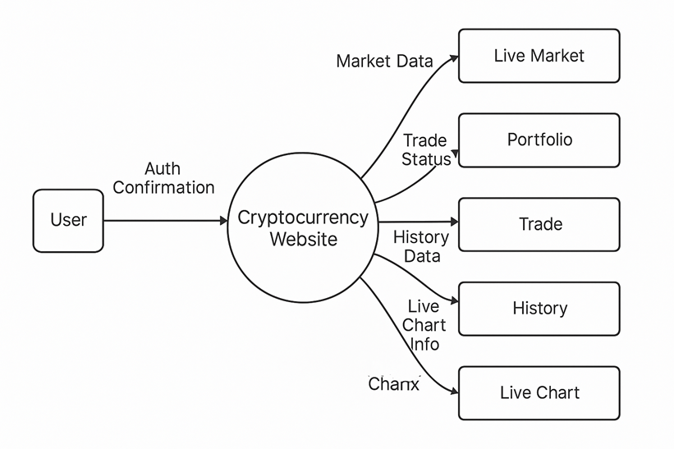
Level 0 DFD

Slide 12
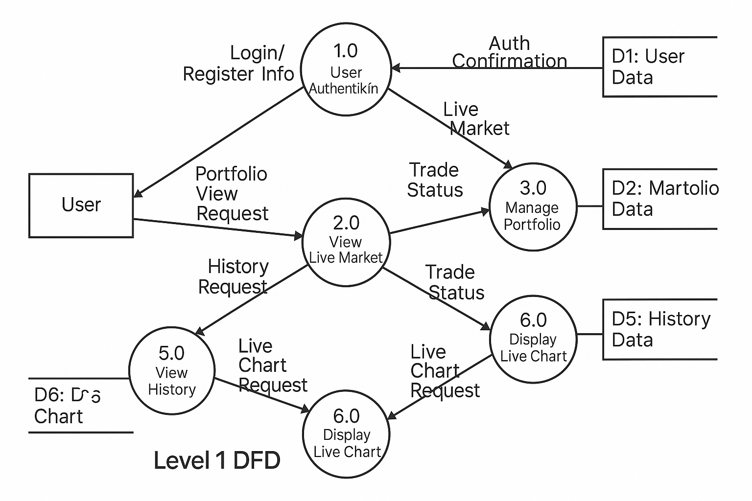
Level 1 DFD

Slide 13
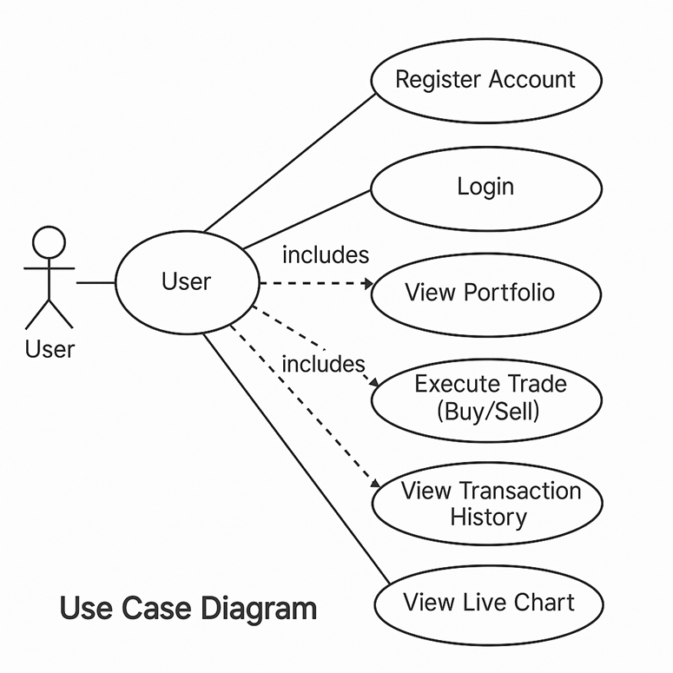
Use Case Diagram

Slide 14
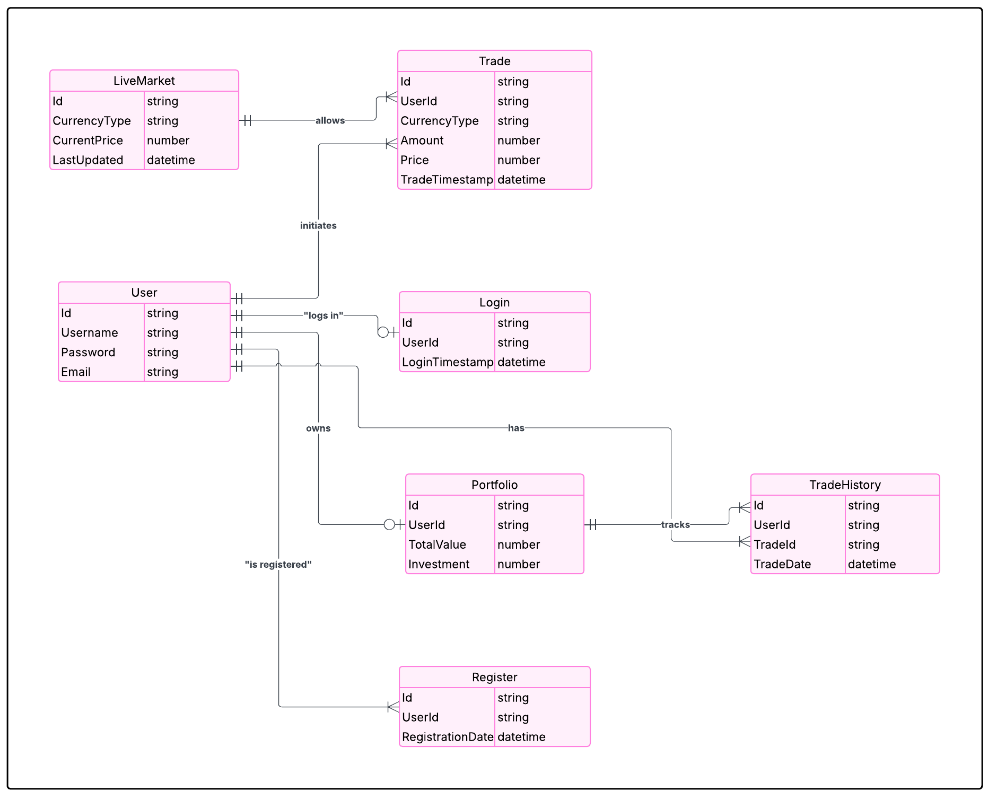
E-R Diagram

Slide 15
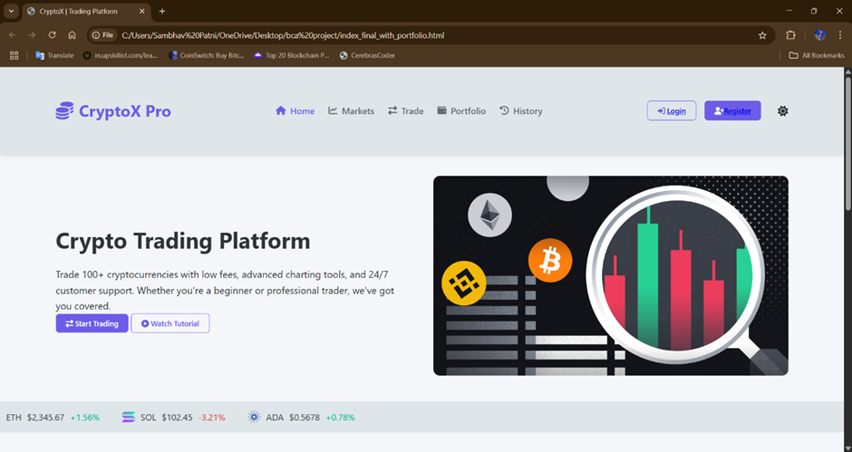

Slide 16
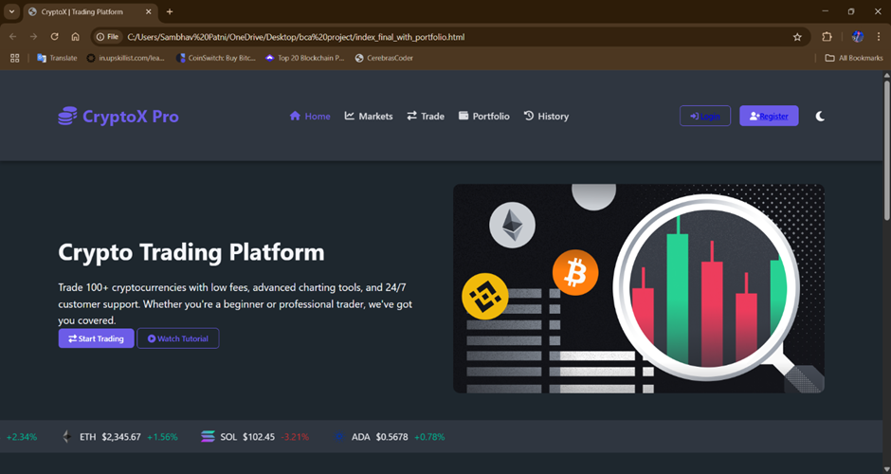

Slide 17
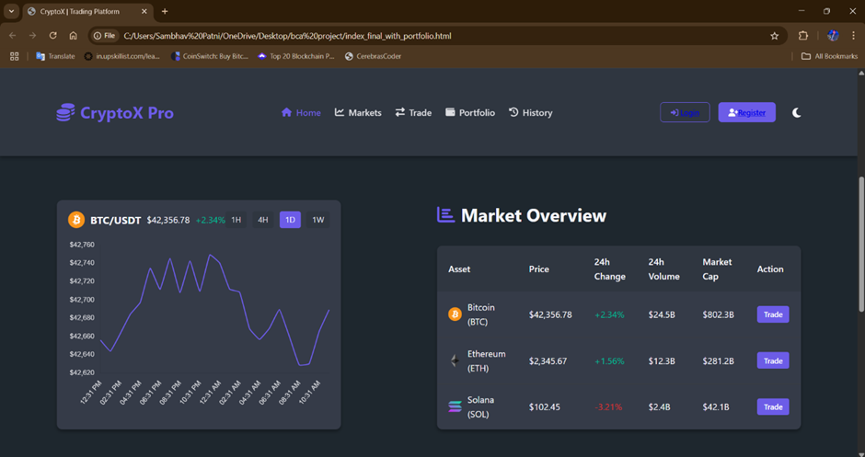

Slide 18
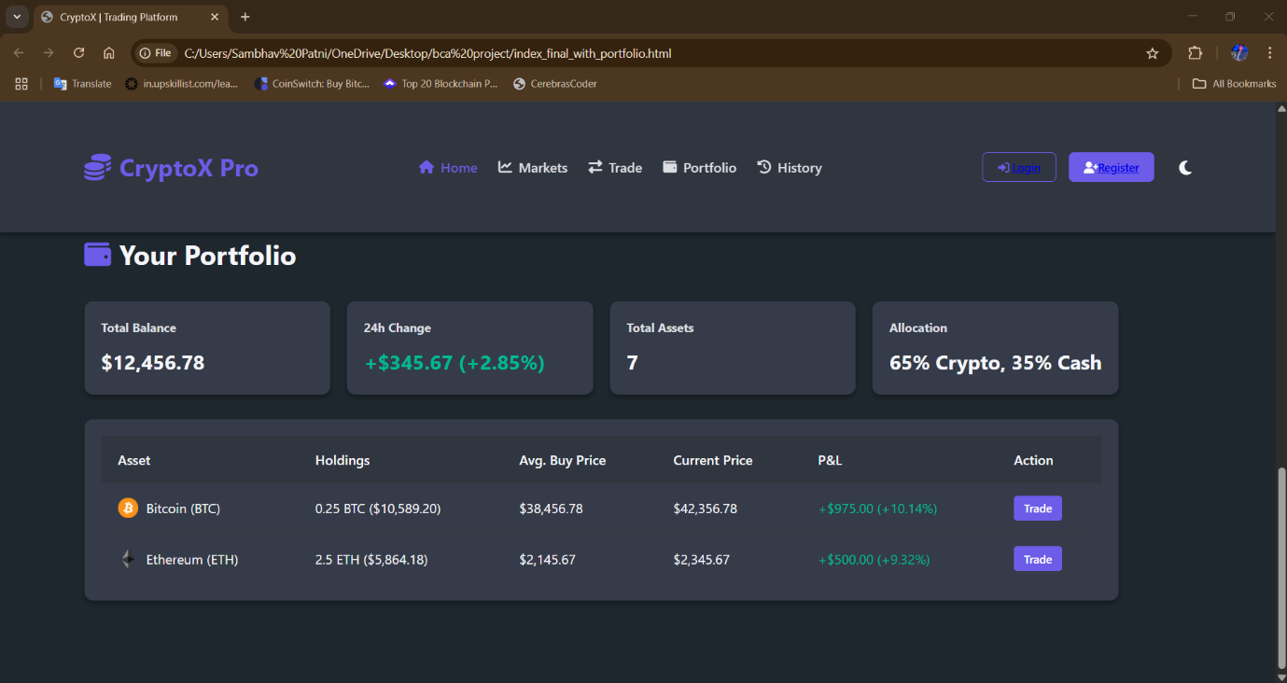

Slide 19
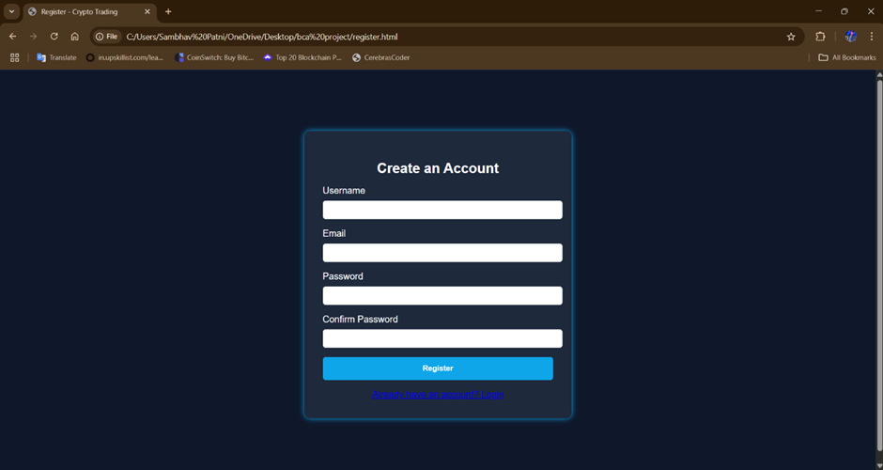

Slide 20
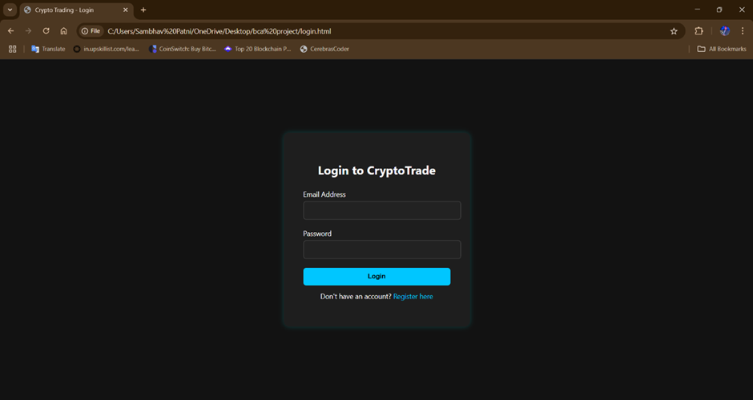

Slide 21
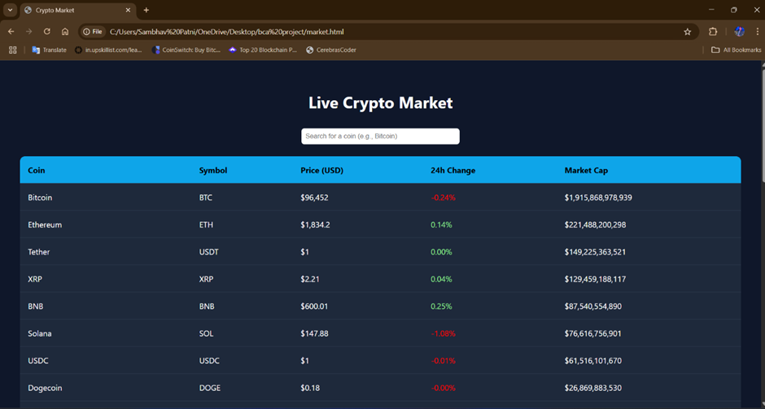

Slide 22
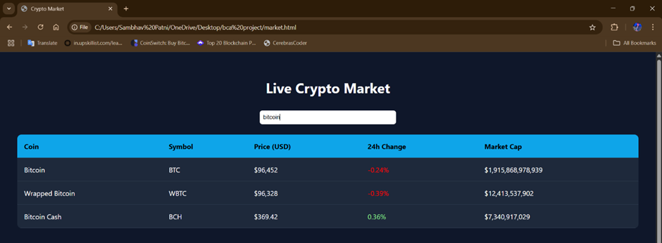

Slide 23
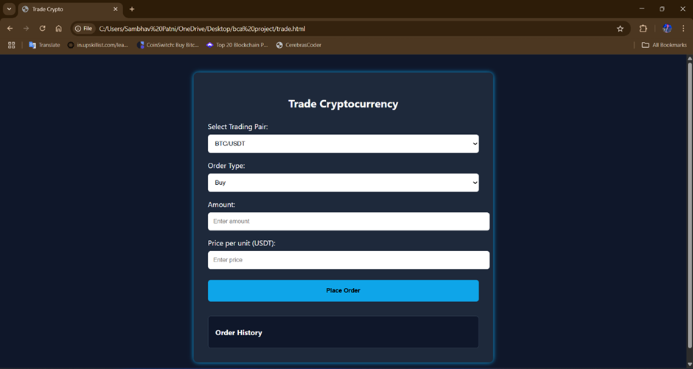

Slide 24
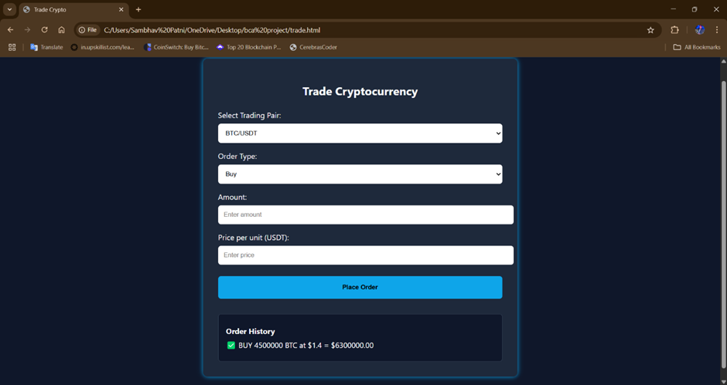

Slide 25
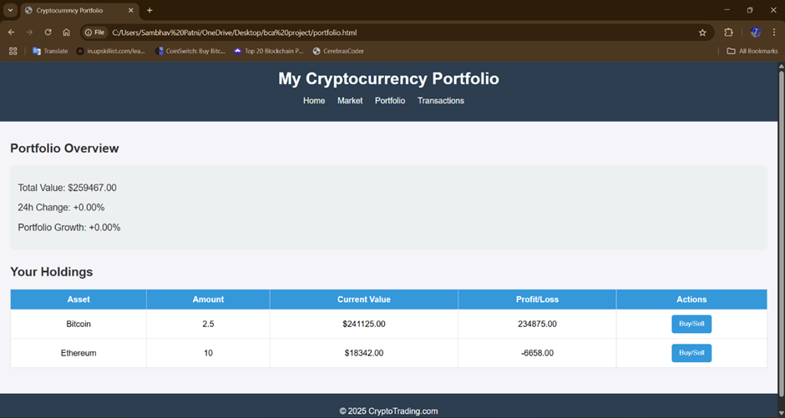

Slide 26
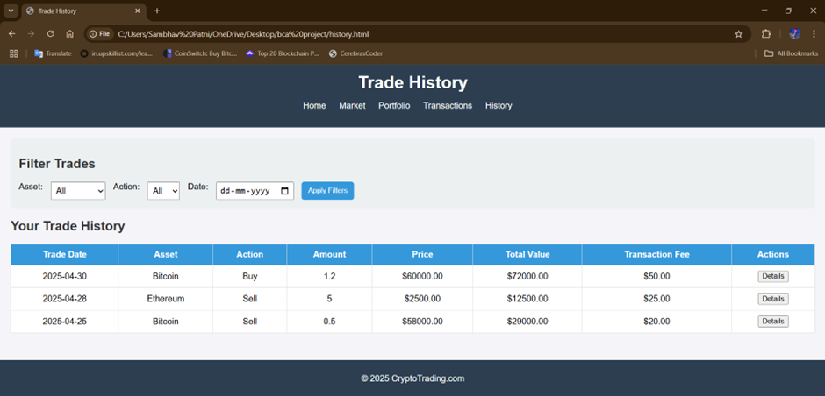

Slide 27
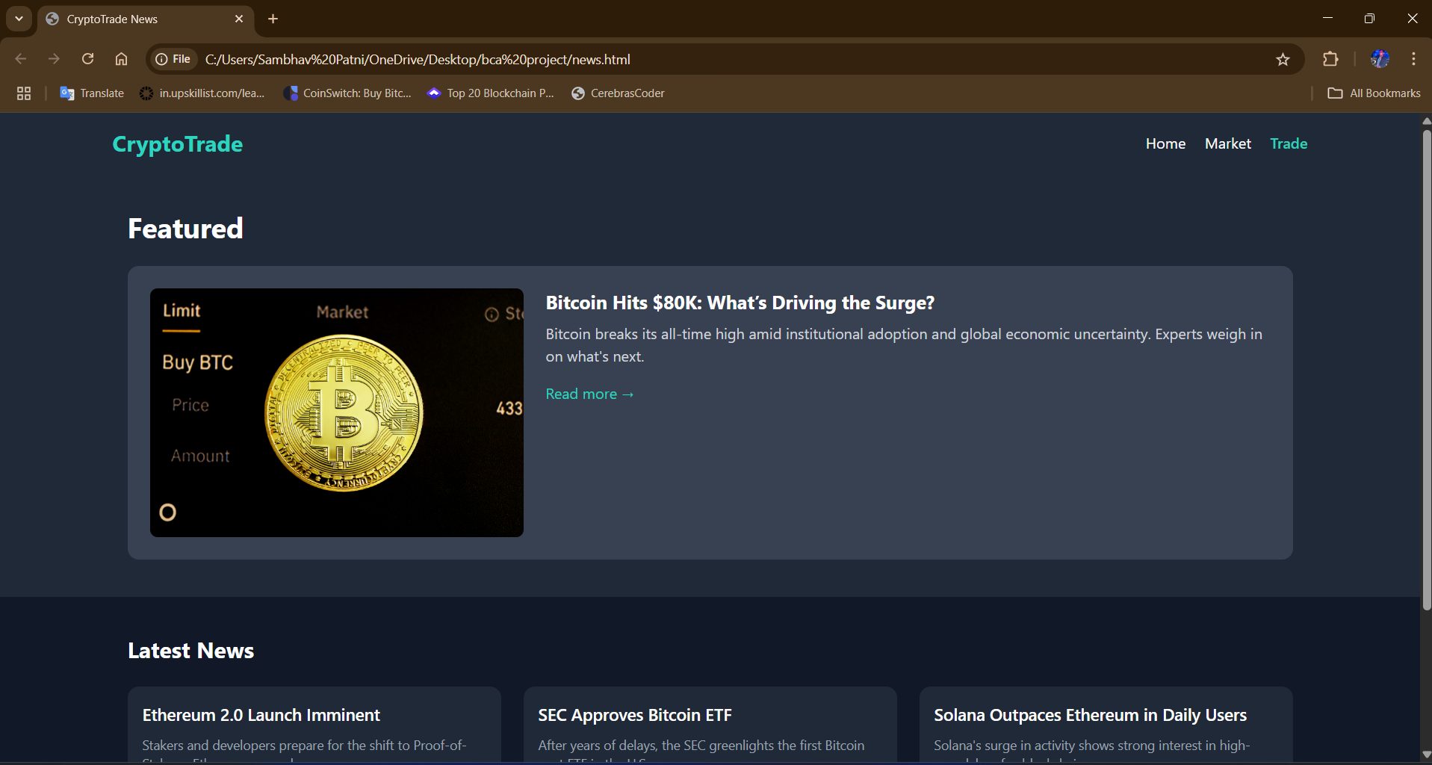

Slide 28
Conclusion
Literature review on Crypto Currency has been done
Initial system – Use case diagram has been made
Initial User interface has been Designed
Trade Access with advanced charting tools and real-time market data analysis
Easily track your portfolio performance and also the transactions made in the history
User-friendly platform suitable for both beginners and professional traders.
Also give the education resources support and a tutorial for the users to get it start without any facing for trading in it

Slide 29
References
[1] Xiao Fan Liu, Xin-Jian Jiang, Si-Hao Liu, AND Chi Kong Tse, “Knowledge Discovery in Cryptocurrency Transactions: A Survey”, IEEE journal, Vol 9, pp 37229-37230, February, 2021
[2] Damianos P. Sakas, Nikolaos T. Giannakopoulos, Nikos Kanellos and Christos Tryfonopoulos, “Digital Marketing Enhancement of Cryptocurrency Websites through Customer Innovative Data Process”, MDPI journal, Vol 10, pp 1-2, April, 2022
[3] Fan Fang, Carmine Ventre, Michail Basios, Leslie Kanthan, David Martinez-Rego, Fan Wu and Lingbo Li, “Cryptocurrency trading: a comprehensive survey”, Financial Innovation – open access journal, Vol 8, pp 1-10, 2022
[4] Nikolaos A. Kyriazis Laboratory of Economic Policy and Strategic Planning, Department of Economics, “A Survey on Efficiency and Profitable Trading Opportunities in Cryptocurrency Markets”, MDPI journal, Vol 12, pp 1-2, April 2019
[5] Amit Bauriya, Akshata Tikone, Pooja Nandgaonkar, Prof. Kishor S. Sakure, “Real-Time Cryptocurrency Trading System”, IRJET journal, Vol 6 , pp 1-4, March 2019

Slide 30
Thank You

